Slide 2


Slide 3














Sponsored by:

Slide 4





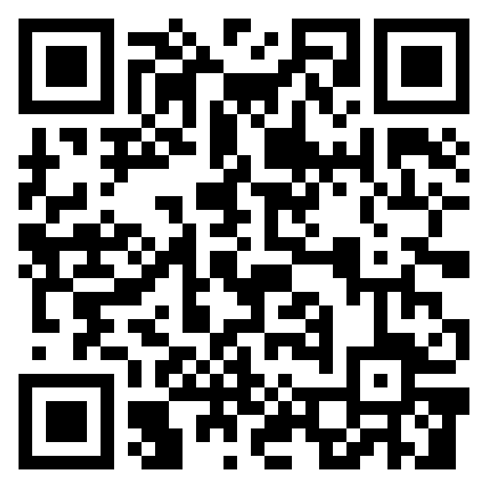



inMaxime Guillemin
Focus
Certifications
Microsoft Intune, MS Graph API & Automation
Microsoft 365 Certified: Endpoint Administrator Associate
Microsoft Certified: Azure Administrator Associate
Microsoft 365 Certified: Security Administrator Associate
From
Hobbies
Picture
Modern Workplace Architect @
Skiing , Scuba Diving & Blogging
My Blog
Contact
Https://cloudflow.be
mg@cloudflow.be

Slide 5
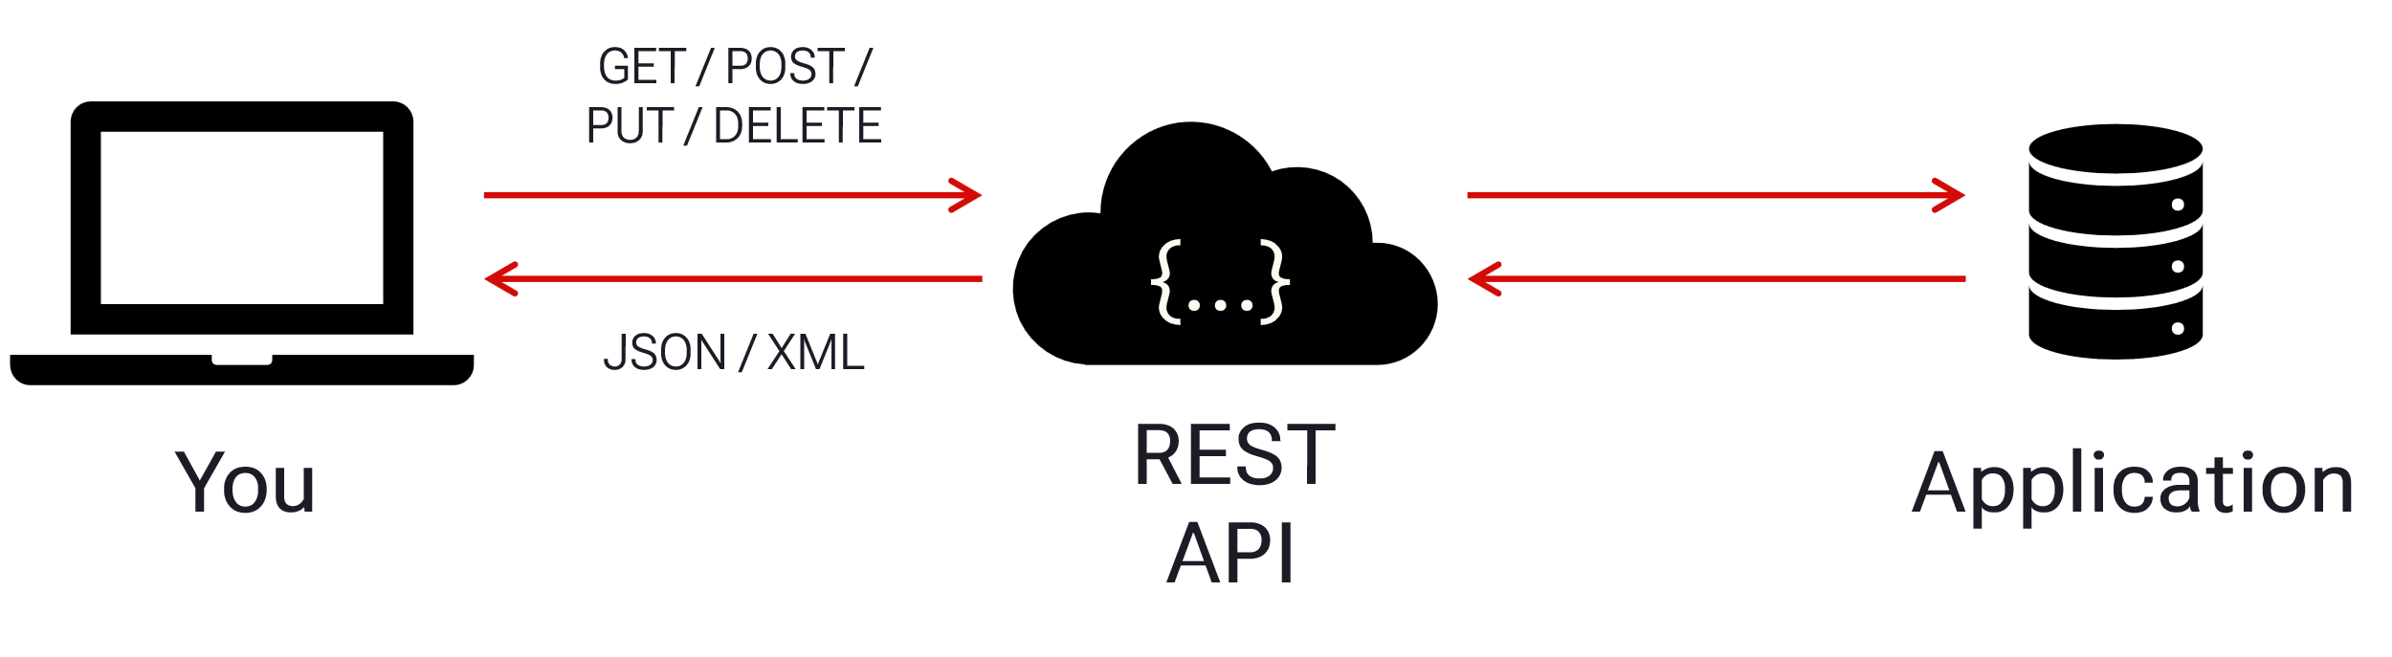
What is Microsoft Graph API ?
Application Programming Interface
REST
HTTP requests
GET, POST, PUT, DELETE, PATCH
e.g. ‘https://graph.microsoft.com/v1.0/devices’
Introduced in November 2015

Slide 6
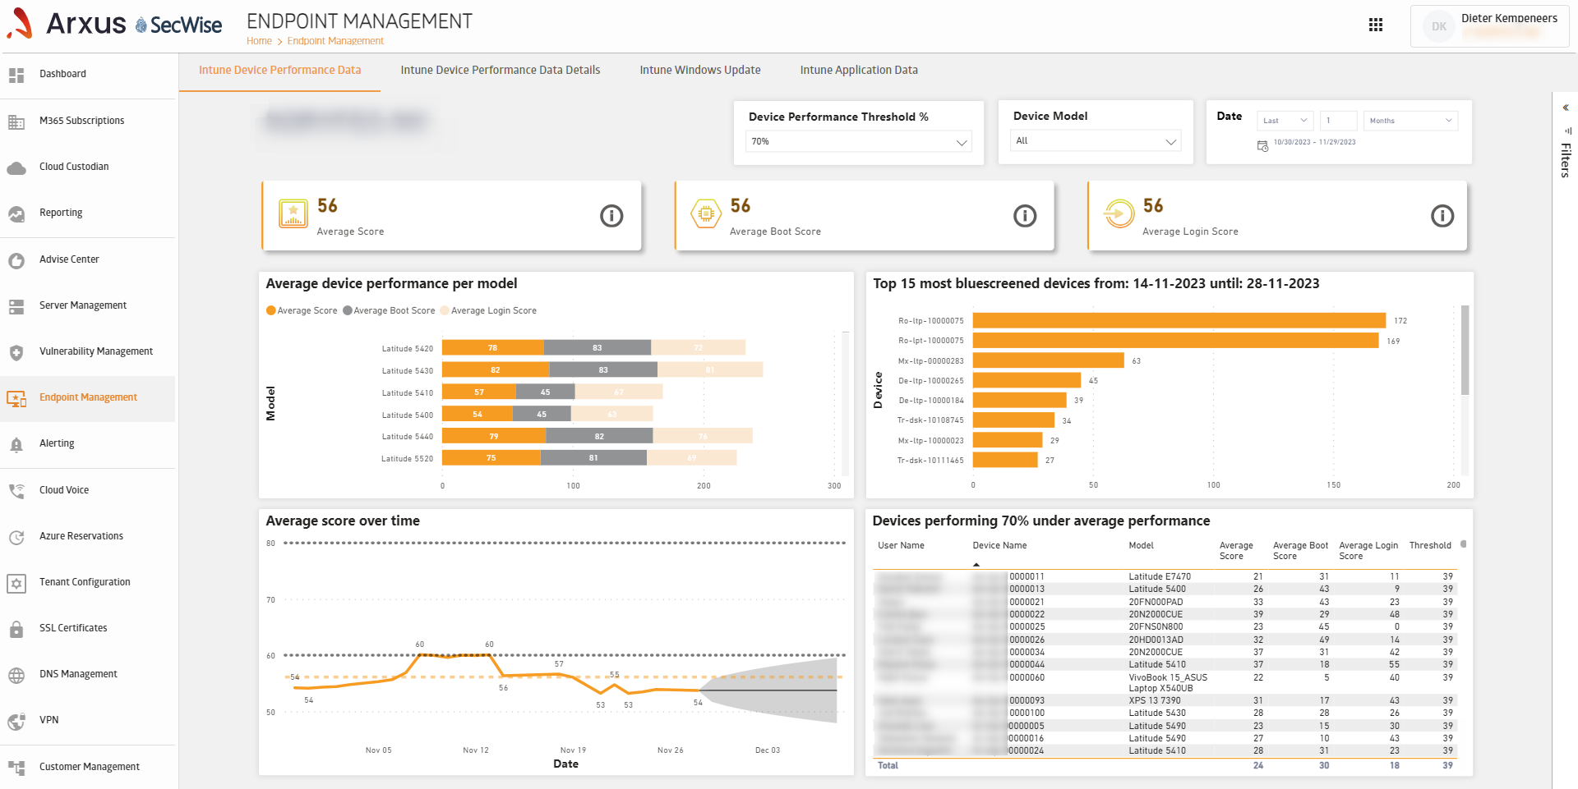

Ms Graph
What can you do with Ms Graph Api?
Analytics And Reporting
Custom Alerts
Automation

Slide 7




Do not edit How to change the design
Who has experience with Graph API
The Slido app must be installed on every computer you’re presenting from

Slide 8
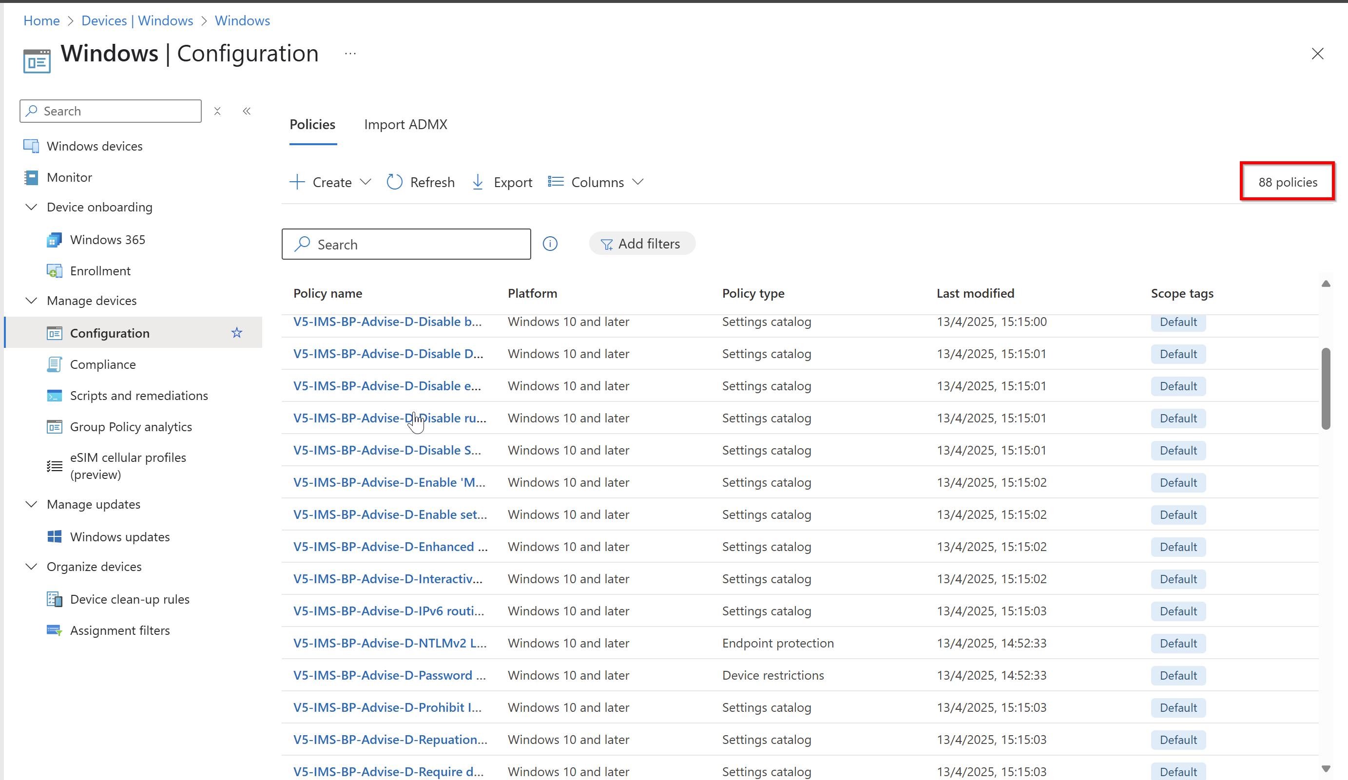
My Problem
88 x 8 clicks x 3 update rings = 2112 Clicks

Slide 9
What do you need to know before we begin
Main Microsoft API
Format
https://graph.microsoft.com/{version}/{resource}?{query-parameters}
Versions
1.0
beta
Finding & Testing Graph urls
MS Documentation
https://learn.microsoft.com/en-us/graph/api/overview?view=graph-rest-1.0
Graph Explorer
https://developer.microsoft.com/en-us/graph/graph-explorer
Check browser inspector network tab
Demo Time

Slide 10
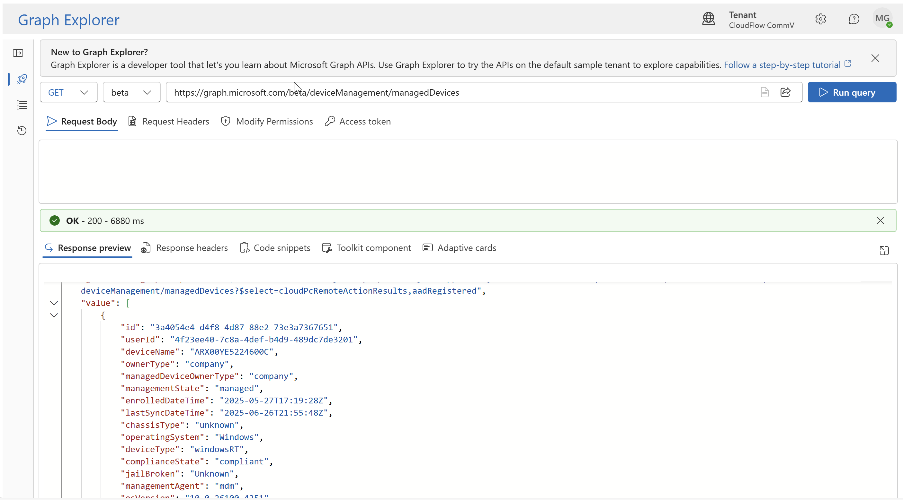
Demo - Microsoft Graph Explorer

Slide 11
Do not edit How to change the design
How much PowerShell experience do you have
The Slido app must be installed on every computer you’re presenting from

Slide 12

PowerShell Model
Install-Module -Name “Microsoft.Graph.Authentication“ -Force -ErrorAction Stop

Slide 13
Connect to MS Graph
# Method 1: Connect using specific scopes
# This method connects to Microsoft Graph with the specified scopes.
# User Experience: The user will be prompted to sign in and consent to the specified scopes.
Connect-MgGraph -Scopes "User.Read.All", "Group.ReadWrite.All"
# Method 2: Connect using specific scopes with device authentication
# This method connects to Microsoft Graph with the specified scopes and uses device authentication.
# User Experience: The user will be provided with a device code and a URL to enter the code. This is useful for scenarios where the user cannot directly interact with the authentication prompt.
Connect-MgGraph -Scopes "User.Read.All", "Group.ReadWrite.All" -UseDeviceAuthentication
# Method 3: Connect using client ID and tenant ID
# This method connects to Microsoft Graph using a client ID and tenant ID.
# User Experience: The user must provide the client ID and tenant ID of the application registered in Azure AD. The user will be prompted to sign in.
Connect-MgGraph -ClientId "<YOUR_NEW_APP_ID>" -TenantId "<YOUR_TENANT_ID>"

Slide 14
Connect to MS Graph
# Method 4: Connect using app-based authentication
# This method connects to Microsoft Graph using app-based authentication with client credentials.
# User Experience: The user must provide the application ID, application secret, and tenant ID. This method is useful for service-to-service calls where no user interaction is required.
# Example usage of Connect-MgGraphEntraApp function
function Connect-MgGraphEntraApp {}
Connect-MgGraphEntraApp -AppId "<YOUR_NEW_APP_ID>" -AppSecret "<YOUR_APP_SECRET>" -Tenant "<YOUR_TENANT_ID>“

Slide 15
Demo Powershell with Ms Graph

Slide 16
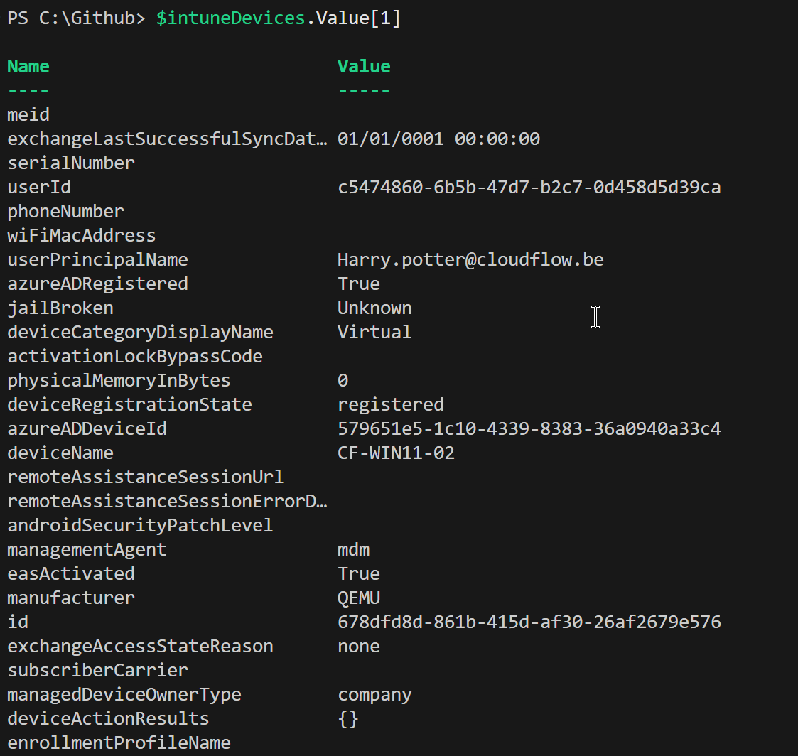
Invoke-MgGraphRequest Get
# Fetch all Intune devices using Invoke-MgGraphRequest
$intuneDevices = Invoke-MgGraphRequest -Method Get -Uri https://graph.microsoft.com/v1.0/deviceManagement/managedDevices

Slide 17
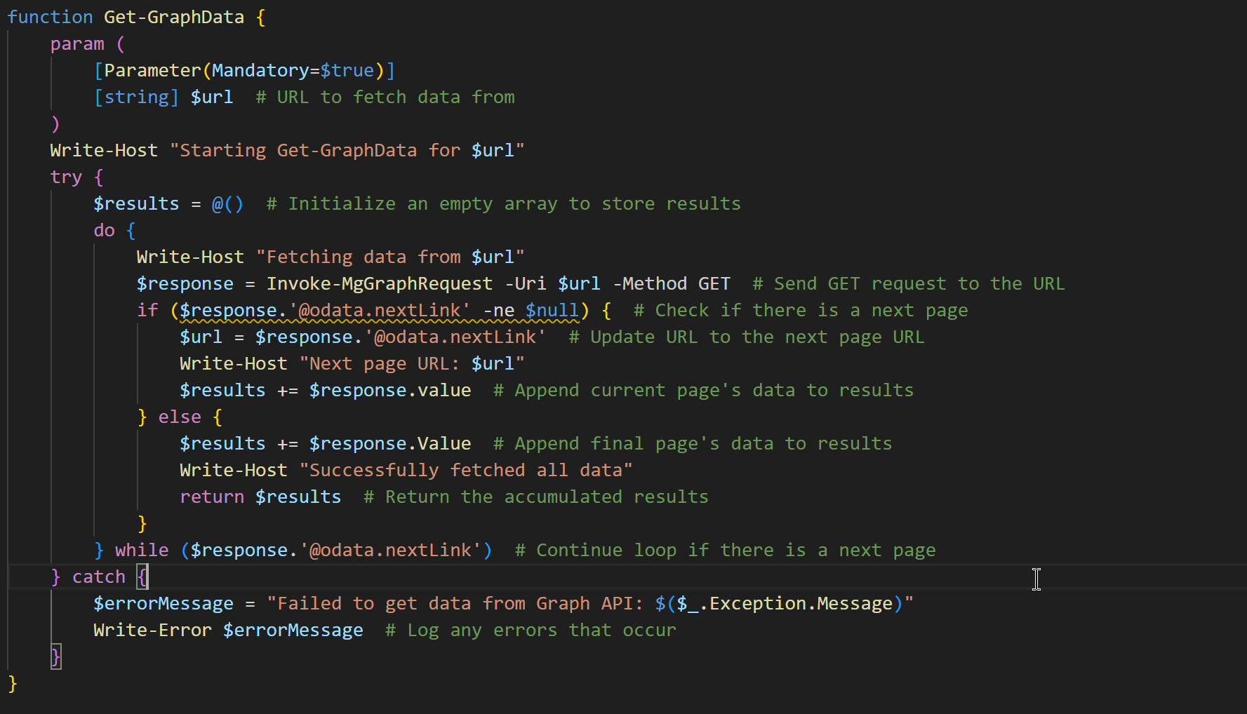
Invoke-MgGraphRequest Paging

Slide 18
Demo Powershell with Ms Graph

Slide 19
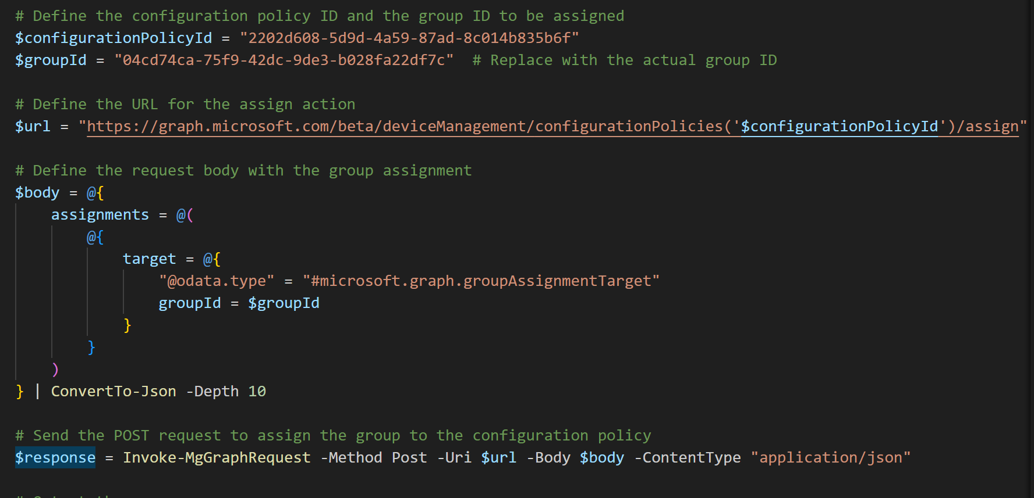
Basic Policy Assignment

Slide 20
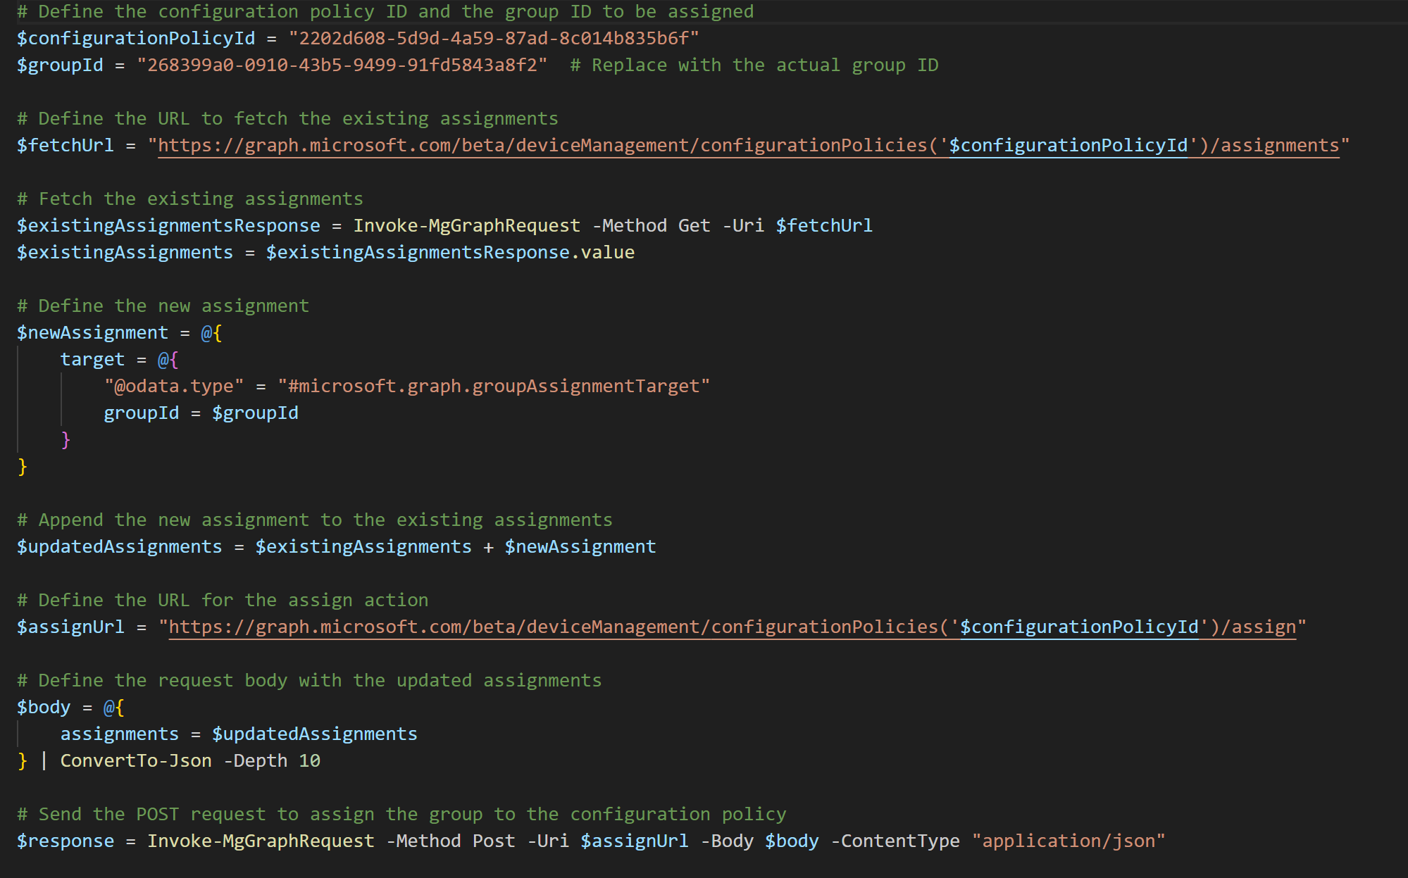
Updating Policy Assignment

Slide 21
Demo Powershell with Ms Graph

Slide 22
Do not edit How to change the design
Are you still with me
The Slido app must be installed on every computer you’re presenting from

Slide 23
Intune-Toolkit

Slide 24
Ms Graph
Things you need to know
No Consistant Syntax
Some Graph Api endpoint are not public and are only opend for first party apps
Microosft Graph api has request limits you need to build in safety to handle ERROR 429

Slide 25
When was Microsoft Graph Api Introduced ?

Slide 26
Questions ?
Thanks for joining the session
https://github.com/MG-Cloudflow/Speaker_Sessions/tree/main/Collabdays%20Hamburg

